Slide 1
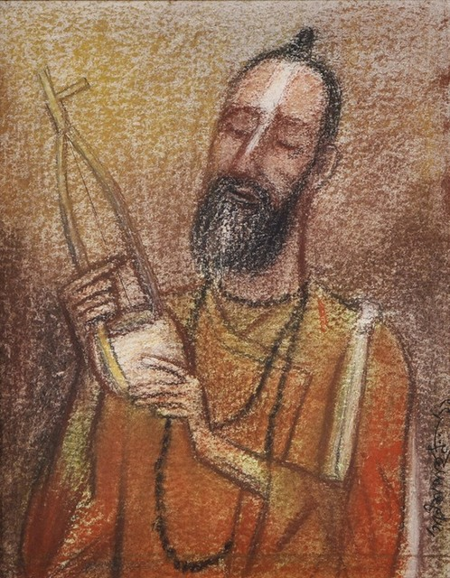
MATERIAL ART, ARCHITECTURE, MUSIC AND FOLK CULTURE
Asif Basar (Mab2)
Lecturer,
Department of History and Philosophy
North South University

Slide 2
Introduction:
Bangladesh has been a center of cultural diffusion since the dawn of history of mankind. It was the meeting ground of various peoples in different states of civilization, the most primitive as well as the most advanced. Every Bangladeshi is proud for the cultural history of Bangladesh along with its glorious heritages. Each phase of the history of Bangladesh has its distinct characteristics and every race of people who came and settled here, left its individual racial, religious or cultural impacts in the form of temples, monasteries and mosques along with their associated objects.

Slide 3
The environment and the agricultural activities greatly helped to enrich the traditional folk-art of Bangladesh. It uses traditional motifs reflecting the land and its people. Different forms of folk art tend to repeat these common motifs. For instance, the lotus, the sun, the tree-of-life, flowery creepers etc. are seen in paintings, embroidery, weaving, carving and engraving. Other common motifs are fish, elephant, horse, peacock, swastika, circle, waves, temple, mosque etc. Many of these motifs have symbolical meanings. For example, the fish represents fertility, the sheaf of paddy -prosperity, the lotus -purity and the Swastika good fortune. Another factor, most important perhaps, that has influenced the art and culture of this land is the six seasons.

Slide 4
The area of the folk-arts of Bangladesh is very wide. The multifarious world of the folk-arts of Bangladesh is made with Alpana (floor painting), designed cake, Patachitra (designed frame), Nakshi Pakha (designed fan), Shital Pati (fancy mats), Nakshi Kantha (embroidered quilt), designed Shika, fancy fans, baskets, flower vases of bamboo and reed, folk-ornaments, folk-musical instruments etc.
Different folk-paintings are made in various religious rites and celebration in the village areas of Bangladesh. Floor painting, painted pots, masks, wall painting, tattooing and other body painting, Patachitra, fancy pots etc. are among them.

Slide 5
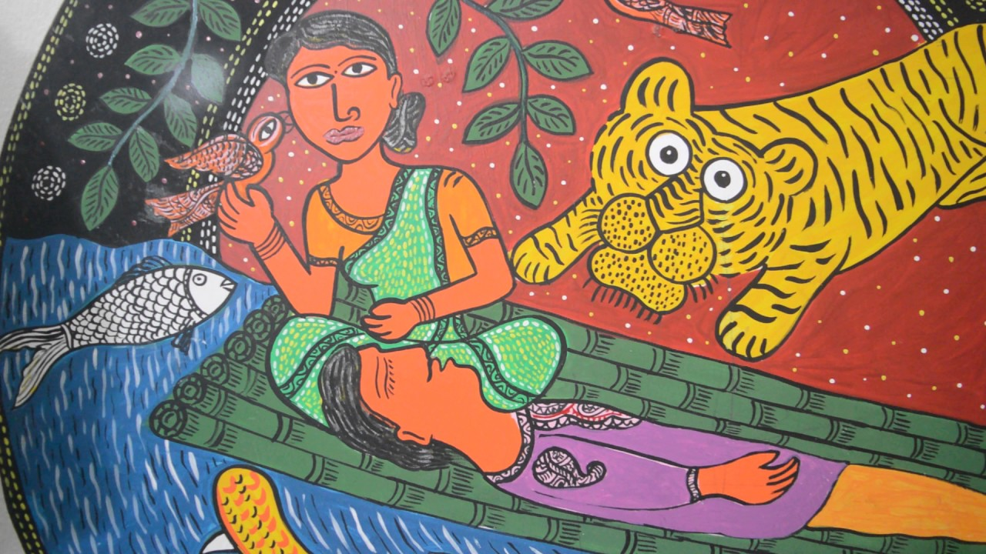
Folk Art:
Folk art encompasses art produced from an indigenous culture or by peasants or other laboring tradespeople. In contrast to fine art, folk art is primarily practical and decorative rather than purely aesthetic. Folk Art is characterized by a naive style, in which traditional rules of proportion and perspective are not employed. There are two types of folk arts: Performing and Non Performing.

Slide 6
Non performing arts:
The folk art of Bangladesh has been largely contributed by the rural women because of the aesthetic value as well as the quality of their work. A key reason behind it was that in most cases their art has been non-commercial, whereas the folk art produced by men has a commercial value attached to it. Thus, artists like blacksmiths, potters, cobblers, painters, goldsmiths, brass-smiths, weavers earn their livelihood from what they produce while traditionally, from the past, Alpana artists or Nakshi kantha needle women were working within the home and received no monetary recompense for their labor. Both Alpana and Nakshi kantha are some of the most attractive forms of Bangladeshi folk art. Pottery and Ivory are also some popular forms of the art

Slide 7
Folk art can be divided into six categories:
Painting | Alpana, painted pots, masks, wall painting etc.
Embroidery | Nakshi Kantha, handkerchiefs, etc;
Weaving | Nakshi Shika, Shital Pati, Nakshi Pakha
Modelling | Dolls and toys, utensils, masks etc.
Engraving | Wooden products, terracotta slabs, metal works;
Inlaying | Ornaments inlaid with gems, pearls, diamond and other precious stones, decorating buildings and houses with colored glass and stones.

Slide 8
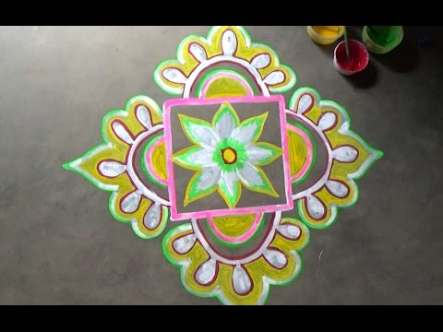
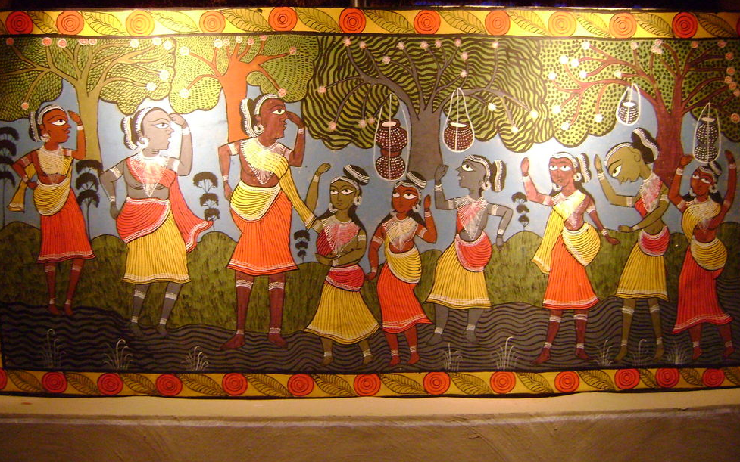
The most popular forms of folk art in Bangladesh are Alpana and Potchitra.
Alpana (Ritual Painting) is a kind of folk art and a spontaneous expression of the artistic sensibility of people. It refers to colorful motifs, sacred art or painting done with hands and paint on auspicious occasions in Bengal. The word Alpana is derived from the Sanskrit alimpana, which means 'to plaster' or 'to coat with'.

Slide 9
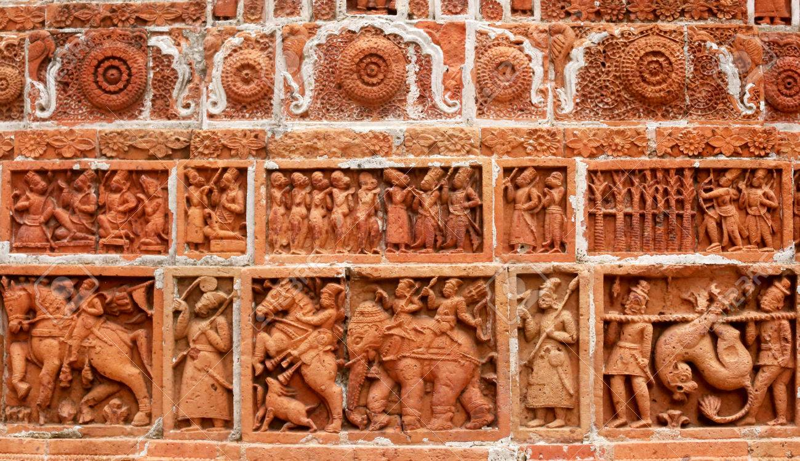
Terracotta is a folk art of baked earth (pora maati) . There are specific themes and subjects based on which terracotta art is produced. A variety of items is made of terracotta – plaques, wall tiles, lamps, pitchers, flower vase, pottery, coin bank, candle-stands, dolls, and more. The designs of these burnt clay products reflect folk tales, picture of everyday life, artistic symbols denoting peace, love and understanding.

Slide 10
Performing arts:
Folk drama is combination of dance, song, music, and acting called as jatra, pala gan, ghatu, gambhira, kavigan etc. Jatra is the most popular form of Folk drama. In Jatras, legendary plays of heroism, mythological stories, folktales of love and tragedy, and similar countless themes are enacted in open air theatre. While some folk dramas emphasize songs, others stress dancing or acting. Folk drama are commonly based on stories of Rama and Sita, Radha and Krishna, Behula and Laksindar, Rahim Badsha and Rupban, Baidyani etc. Folk dramas usually have a mythical, historical, religious and political flavor.

Slide 11
Music
The musical tradition of Bangladesh is lyrics-based, with minimal instrumental accompaniment. We can classify folk songs in seven categories: love, ritual, philosophy and devotion, work and labour, profession and occupation, satire and fun, and mixed. On the other side there are different forms of Folk music, Baul, Gombhira, Bhatiali, Bhawaiya, kavigan, ghatu gan, jhumur, baramasi, meyeli git, jatra gan, sari gan, etc. The Baul tradition is a unique heritage of Bangla folk music, and there are numerous other musical traditions in Bangladesh, which vary from one region to the other. Gombhira, Bhatiali, Bhawaiya are a few of the better-known musical forms. Folk music of Bengal is often accompanied by the ektara, an instrument with only one string.

Slide 12
Baul Song
The word “Baul” first appeared in Bengali text around the 15th century, and over time became a recognized and popular musical genre. It is the overall literary value of the works, the philosophy and spirituality in the unique music, together with the Baul’s emphasis on living life in closest proximity with nature’s climactic cycles, cosmology, their food habits, social rites and rituals, spirit of tolerance and secularism makes it one of our most phenomenal cultural component. The Bauls believe that God is hidden in the heart of man, and neither priest nor prophet, nor the ritual of any organized religion, will help man to find him there. The Baul feels that both temple and mosque stand across the path of truth, blocking the search. The search for God is one which everyone must carry out for himself

Slide 13
The charm of the Baul songs lies in two things: that they are folk songs, in the sense that they come spontaneously from the hearts of people and speak therefore to the hearts of people even of a very different culture; and they are songs which speak of certain universal mysteries of life, graced with a human and very real dignity. It has been said in one of the Baul songs:
“Oh Lord! With what can I worship You?
Pray, tell me which flower I may offer?
The malati or beli, or the golden parijat
From the garden of Paradise?
If, by repeating Your name, these flowers will bloom Inside my own heart, then Perhaps from my chanting
Your name, my eyes will eventually
Open like them to admire You.”

Slide 14
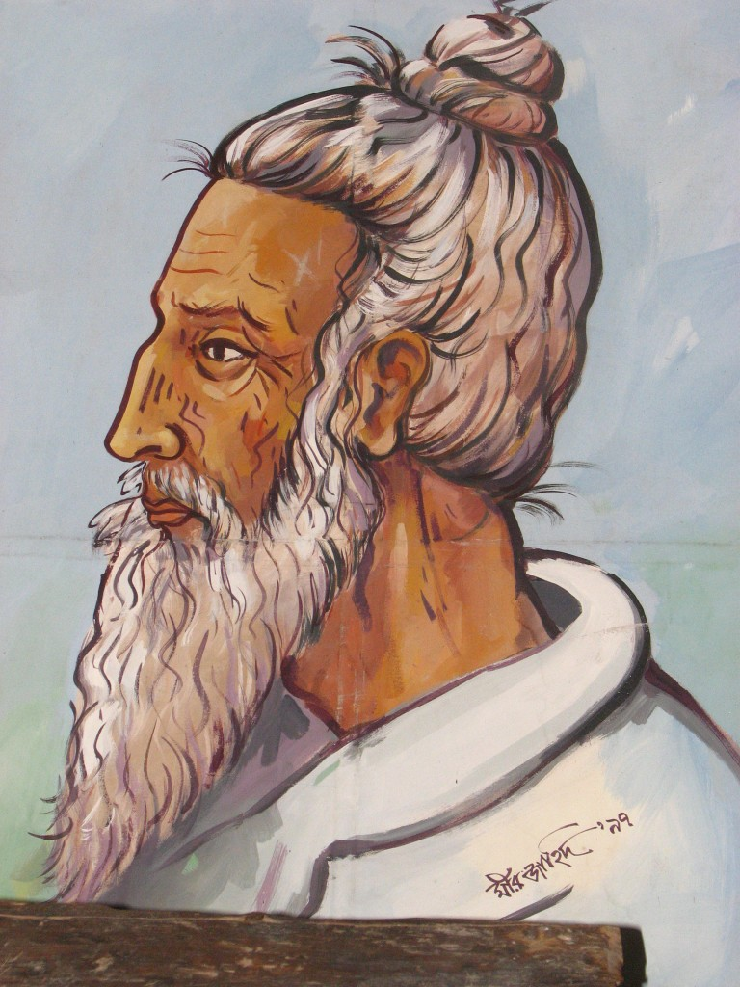
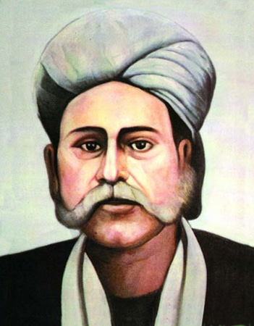
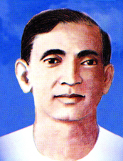
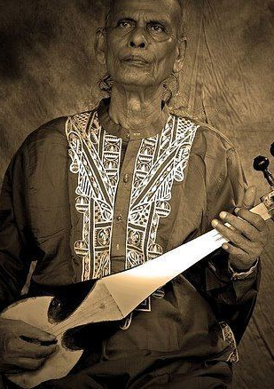
Fakir Lalon Shah
Hason Raja
Abbasuddin Ahmed
Shah Abdul karim

Slide 15
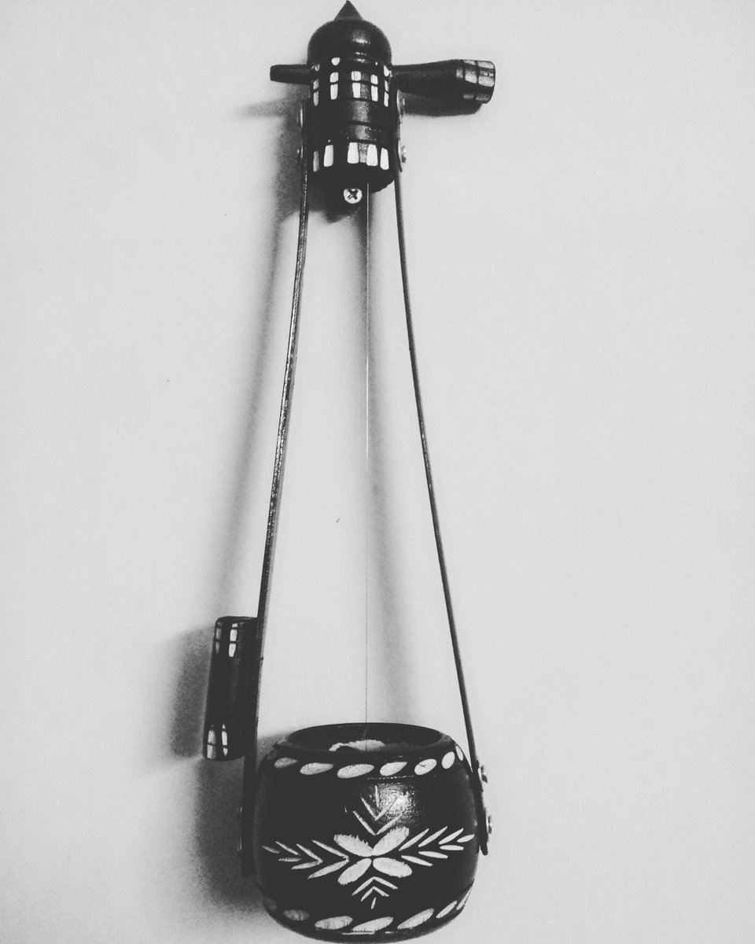
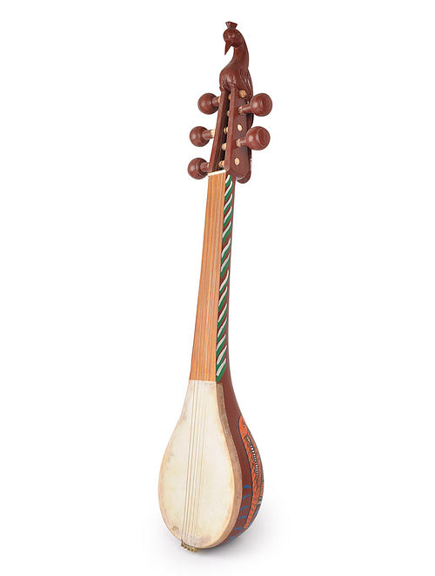
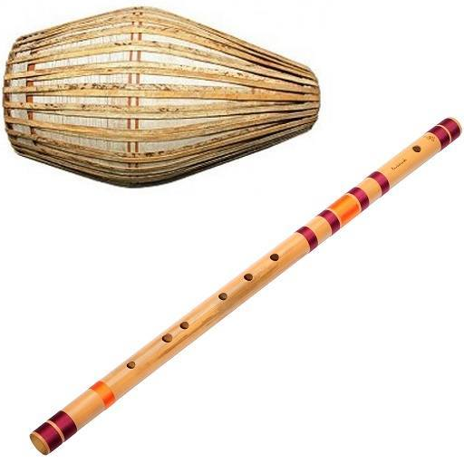
Aktara
Dotara
Dhol and Fluete

Slide 16
Fakir Lalon Shah
Little is known about the personal life of Lalon Shah. He was probably married in his boyhood. Sometime in early years of his life, Lalon happened to be a victim of small pox while in a journey to visit the places of pilgrimage. His companions abandoned him on the way. A Muslim fakir, Siraj Sanyi rescued him in a dying condition and got him recovered by nursing and medical treatment. After his recovery Lalon returned to his house, but was denounced by his wife and the relatives since he had been under the shelter and association of the Muslims. Disappointed and disheartened, Lalon returned to Siraj Sanyi, initiated with him in Baul doctrine and devoted himself in austere ascetic practice. After the death of his Guru, Lalon established his akhda (monastery) at Chheunriya on the bank of the Kaliganga, and passed his days there in austerity, composing and singing devotional songs.

Slide 17
Lalon had no institutional education. By his devotion he acquired deep knowledge on the religious doctrines of the Hindus and Muslims, the manifestation of which is found in the songs composed by him. He composed nearly two thousand five hundred devotional songs. His songs are rich in mystic trend of thought and in artistic skill. Composed in simple language his songs are significant and impressive, and are indicative of ideal of human life, humanism and non-sectarian attitude. His disciples used to sing his songs. Even in his life time, a colossal Baul community developed consisting of his disciples and of their disciples. His disciples like Kangal Harinath Majumder, Pagla Kanai etc earned reputation as composer of Baul songs.

Slide 18
Architecture
Ever since the consolidation of Mughal rule in Bengal in the beginning of the 17th century, the architecture of this area, specially in and around the capital followed the imperial Mughal tradition of Delhi. Consequently much of the distinctively regional characteristic of pre-Mughal architecture was lost.
A refined Mughal provincial style was developed in Dhaka during the 17th century when it was the capital city. Here the terracotta of the previous centuries is replaced by plaster decorated surfaces, and niches and foliate motifs are used as ornamental devices.

Slide 19
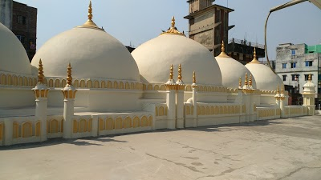
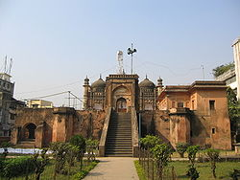
Two mosques in Dhaka which date from the early 18th century mark the termination of the high tradition of Mughal architecture in Bengal which had developed in the previous century. These are Kartalab Khan's mosque in Begumbazar, reportedly built by Murshid Quli Khan when he was residing in Dhaka between 1700-1703, and Khan Muhammad Mridha's Mosque in Lalbagh dated by inscription to 1704.
Kartalab Khan's mosque
Khan Muhammad Mridha's Mosque

Slide 20
The Mughals continued the tradition of mosque buildings without any enclosed courtyard which was standardized during the Sultanate period. Traditionally, the building material was well-fired brick, and the mortar was of powdered brick and lime which was often obtained from snail shells. The plans of these mosques are typically Mughal. They are single-aisled and divided into bays by cusped lateral arches, Kartalab Khan's Mosque has five bays, and Mridha's Mosque, three. Their wall surfaces are plastered, and the exterior articulated by rectangular panels.
Several 18th century mosques have suffered demolition, and much enlarged, multi-storied mosques have been built on their sites.

Slide 21
The decline of Mughal power in Delhi gave rise to a new class of officials in the province. Although key posts in the administration were given to Murshid Quli Khan's relatives, the bulk of the officials, specially in the revenue department, were all Hindus, and many large zamindaris were also granted to them. These powerful hereditary landlords were allowed almost full autonomy so long as they sent the required revenues to the provincial court. The temples that they built were large and elaborate, e. g. Kantaji's temple at Kantanagar in Dinajpur. After Farrukh Siyar's farman to the East India Company in 1717, there was considerable expansion of British trade. Soon there arose a new wealthy class of entrepreneur traders called banians who mediated between producers and the East India Company.

Slide 22
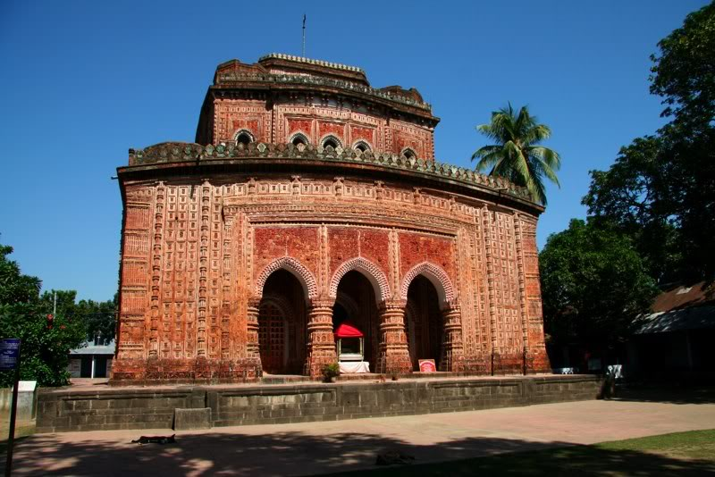
With the decline of nawabi rule in the second half of the 18th century, these newly rich Bengalis started to purchase landed estates as investment and earned the title of zamindar. Consequently, a large number of temples were built in areas linked with foreign trade specially in Hughli, Midnapur, Burdwan, Howrah and Birbhum districts. In addition to providing influence and prestige, temple building was a means of social recognition and mobility.

Slide 23
The Orissan rekha deul of the northern Indian temple type is the most important stylistic influence. This is evident in the rhythmically organized projections and recesses of the outer walls and the massive walled towers with hollow interiors constructed of brickwork.
The hut styles imitated the village houses of mud or bamboo with thatched roof. Whereas in the Muslim tradition of Sultanate Bengal only certain elements of hut architecture, like the curved cornice was translated into brick, we now see entire hut structures built in brick.
The jor-bangla or twin hut is the most distinctive indigenous contribution to temple architecture. It consists of two attached ek- banglas, the one behind being the actual shrine. It is found scattered over a wide area from Purulia to Faridpur, and concentrated in Jessore, Khulna and Pabna districts.

Slide 24
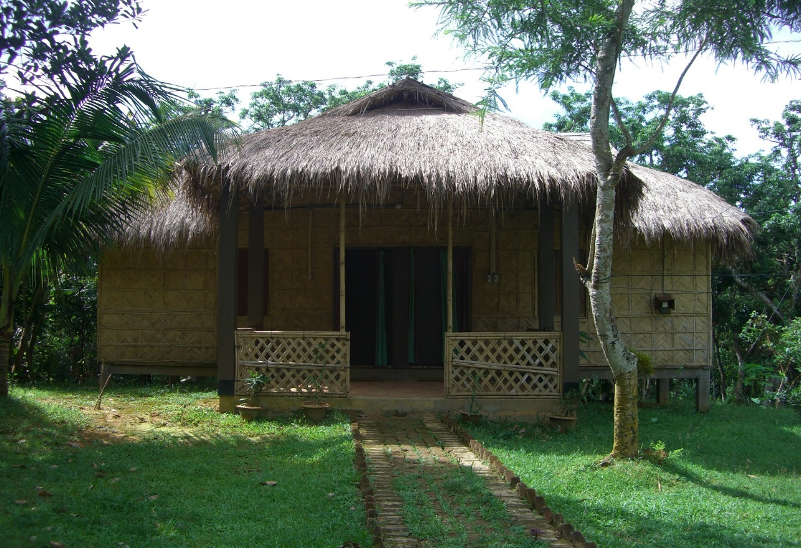

Char-chala have roofs with four sloping sections which come to a point on top if the base is square, and to a ridge if rectangular. If the chamber is square it is surmounted by a dome on pendentives in the interior.

